Slide 1
Chapter 3
Network Connectors and Wiring Standards

Slide 2
Bounded Network Media
Copper Media
Fiber Optics Media
Notes:
The 2 media types we will need to know in-depth for this course

Slide 3
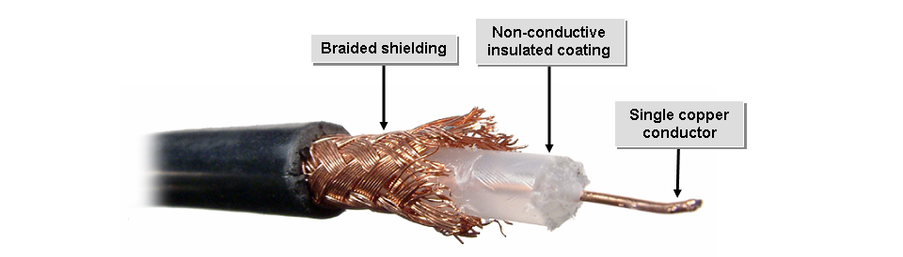
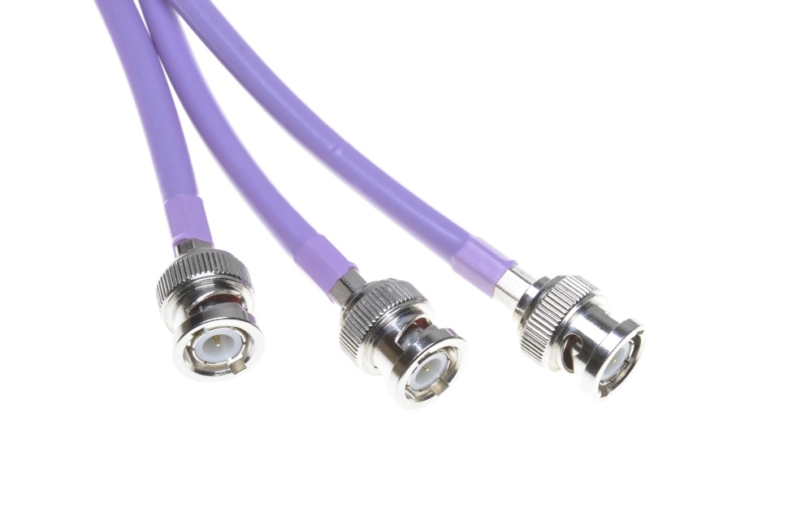
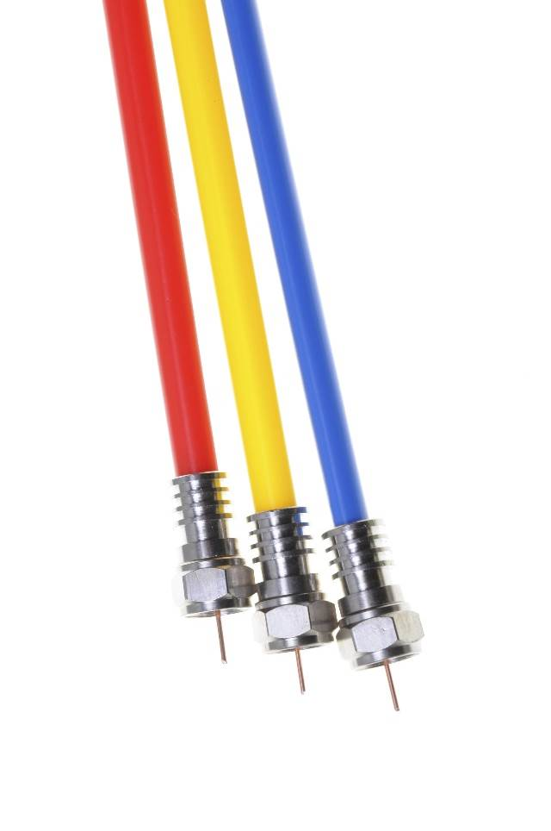
Coaxial Cable
Plenum Rated Cable
ThinNet
RG-58
Must use BNC
BNC Connectors
F-Type connectors
Notes:
Plenum cable is cable that is laid in the plenum spaces of buildings.
A plenum space is typically a space between the floors of a building
Cables that are non-plenum rated give off poisonous smoke if it catches fire
ThinNet = thin coaxial cable, same as the thick coaxial except its diameter is smaller
You must use BNC connectors w/ a ThinNet

Slide 4
Twisted Pair Cable
UTP:
No shielding around conductors.
Typically contains four pairs of stranded or solid conductors.
Inexpensive and reliable.
STP:
Shielding around conductors.
Typically contains four pairs of stranded or solid conductors.
More expensive than UTP.
Notes:
STP help to protect data transmission from Electromagnetic interference (EMI)

Slide 5

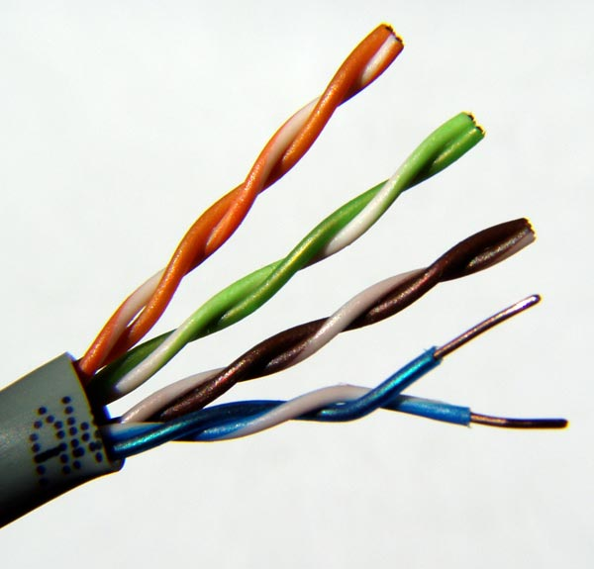

Cat 5e UTP Cable

Slide 6
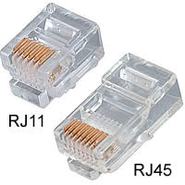
RJ Connectors
Notes:
RJ-11s tend to go on phone lines or in phone jacks
RJ-45s go on the Ethernet cables

Slide 7
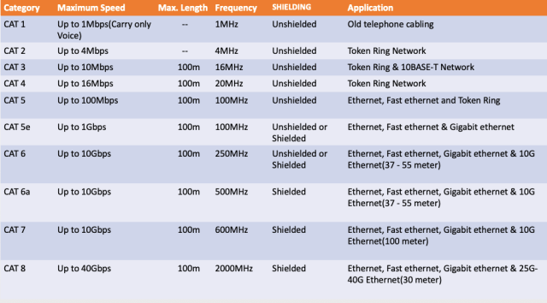
Twisted Pair Categories
Notes:
Your objectives only want you to remember Cat5-Cat8
The way you read charts like this is to find the similarities and differences
The max length for all is 100m
Cat 6, 6a, & 7 are all up to 10Gbps
Cat5e speed is 1000Mbps or 1Gbps
Cat 8 goes up to 40Gbps

Slide 8
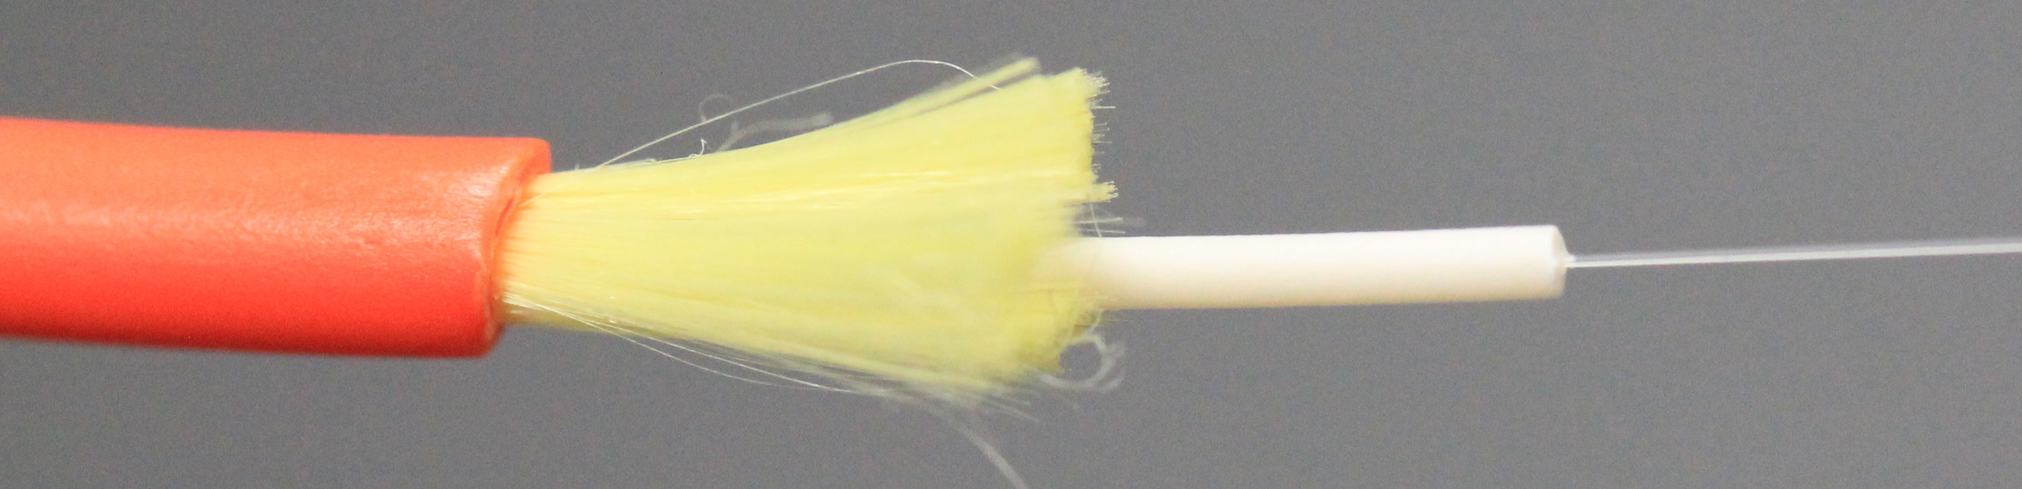


Fiber Optic Cable
Outer jacket
Strengthening fibers
Plastic coating
Glass fiber
Single Mode Fiber
Multi Mode Fiber
125 µm
125 µm
9 µm
50 or 62.5µm
Notes:
Fiber optic cables are immune to Electromagnetic Interference (EMI) and Radio Frequency Interference (RFI)
Fiber sends digital signals using light instead of electricity
It carries the light on either glass or a plastic core
The difference between the nodes is the number of light rays/signals it can carry
Single-mode is for long distance and multi-mode is for short distance
SMF is very high speed and long distance, it uses LEDs and lasers to transmit light
Can transmit distances up to 40km = 25miles
MMF uses light as well, but it uses multiple paths and the light reflects back
Distances can only go up to 3,000ft, it is not very reliable

Slide 9

Fiber Optic Polishes
Polish Type | Description
PC | Physical Contact End faces slightly curved or spherical Back reflection about -40 dB Used in most applications
UPC | Ultra Physical Contact Extended polishing Back reflection about -55 dB Used in digital CATV and telephony
APC | Angled Physical Contact Industry-standard 8 degrees of curvature Back reflection about -70 dB Used in CATV and analog
Notes:
APC is Angled Physical contact
UPC is Ultra Physical Contact
With the UPC light is reflected back down to the core of the fiber cable, which causes a loss of db
DB is how much data gets loss in transit
The APC doesn’t have nearly as much DB loss because of the way it is angled

Slide 10
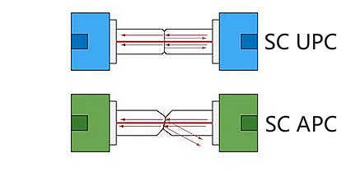
APC vs UPC
Notes:
With the APC, the light isn’t reflected directly back into the fiber cable like it is in the UPC
Light being reflected back causes data to be lost

Slide 11




Fiber Optics Connectors
Fiber Connector | Description
ST | Similar in appearance to BNC connectors (straight ceramic center ping and bayonet lug lockdown) Connect multimode fibers Common in network patch panels
SC | Box-shaped connectors snap into a receptacle Connect single mode and multimode fibers Common in duplex configurations
LC | Half the size of ST and SC with an RJ-45-type latching Connect single mode and multimode fibers Used to transition from twisted pair to optical fiber cabling
MTRJ | Comparable in size to RJ-45 with a snap-to-lock connector Connect two multimode fibers Also called Fiber Jack
Notes:
The two most popular connectors are Straight Tip and Square Connector
ST screws on just like a BNC
The SC has a latched mechanism on it to keep it from simply falling out
SC can be used for single-mode or multi-mode
The two Small Form-Factor Connectors are the LC and the MTRJ
LC is a small form factor connector, available in SMF and MMF, also has UPC and APC polish types
MTRJ has two MMF inside of the connector

Slide 12
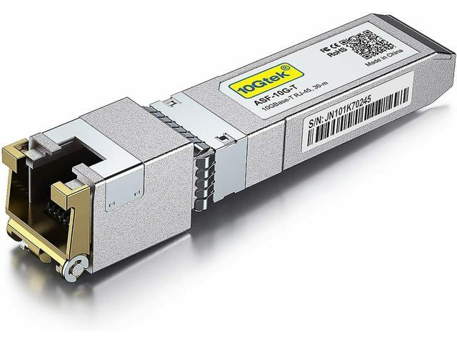
Fiber Optic Transceivers
Transceiver Type | Description
GBIC | Gigabit Interface converter Converts electrical signals to optical signals and vice versa High-speed network interface Variable wavelength Short-wave connects devices between 0.5 and 500 meters Long-wave connects devices between 2 and nearly 10 meters
SFP | Small form factor pluggable Converts electrical signals to optical signals and vice versa Common in 2 Gbps and 4 Gbps Fibre Channel components Smaller than GBIC
SFP+ | Supports 8 Gbps Fibre Channel Supports 10 Gbps Ethernet Supports OTU2 standard
QSFP | Quad SPF Four channels Supports 10 Gb transmissions
Notes:
Transmitters are devices that have both a transmitter and a receiver
You will see these in switches, routers, and on servers to be able to insert your fiber connection
SFP is used for telecommunication and data communications applications
SFP+ is the enhanced version that allows for data up to 16Gbps
QSFP allows for even more speed and the QSFP+ is used for 100Gbps links

Slide 13
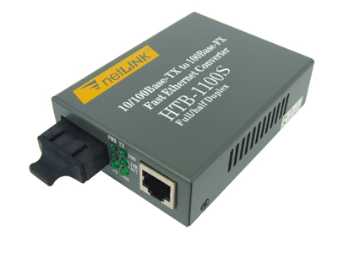
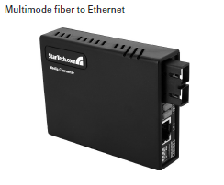
Media Converters
Notes:
Sometimes you need to convert one type of media to another
The Single-mode Fiber to Ethernet accepts a fiber connector and an Ethernet connector
The Multi-Mode Fiber to Ethernet does the same thing except with only MMF

Slide 14
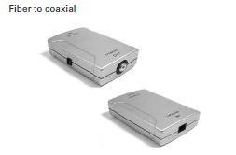
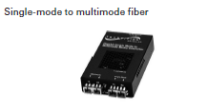
Media Converters (Cont.)
Notes:
The Fiber to coaxial converts digital signals from optical to coax
SMF to MMF converts between the two

Slide 15
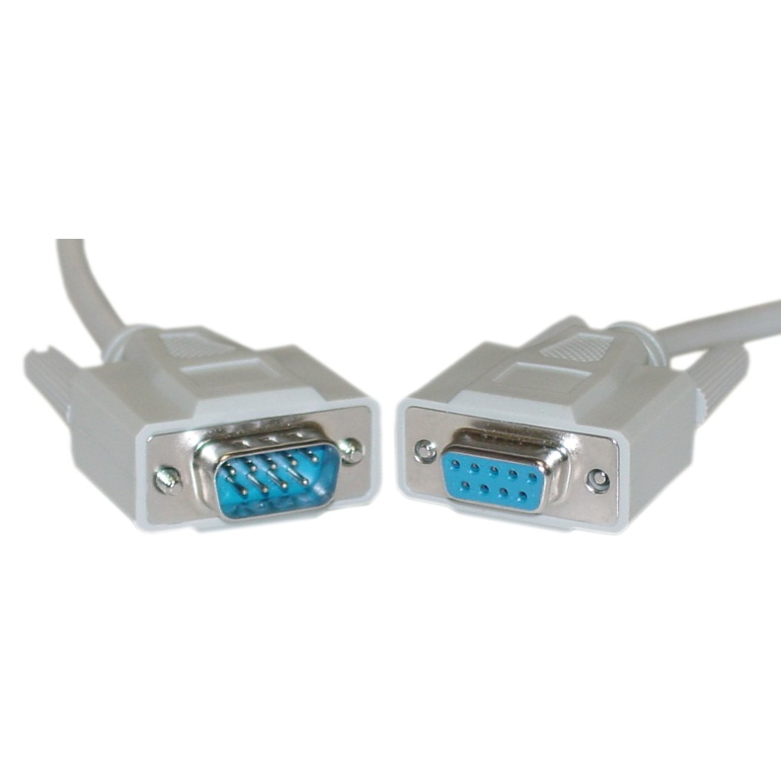
Serial Cables
An RS-232 cable end Figure 3.16
Notes:
Commonly used for serial data signals.
Legacy way of data communicating for devices using different manufacturers
Think of connecting a computer’s serial port to an external modem
Normally have a DB-9 connector
DB-9 has 9 pins
A DB-25 has guess how many pins?

Slide 16
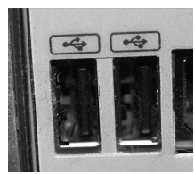
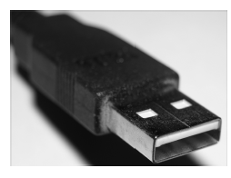
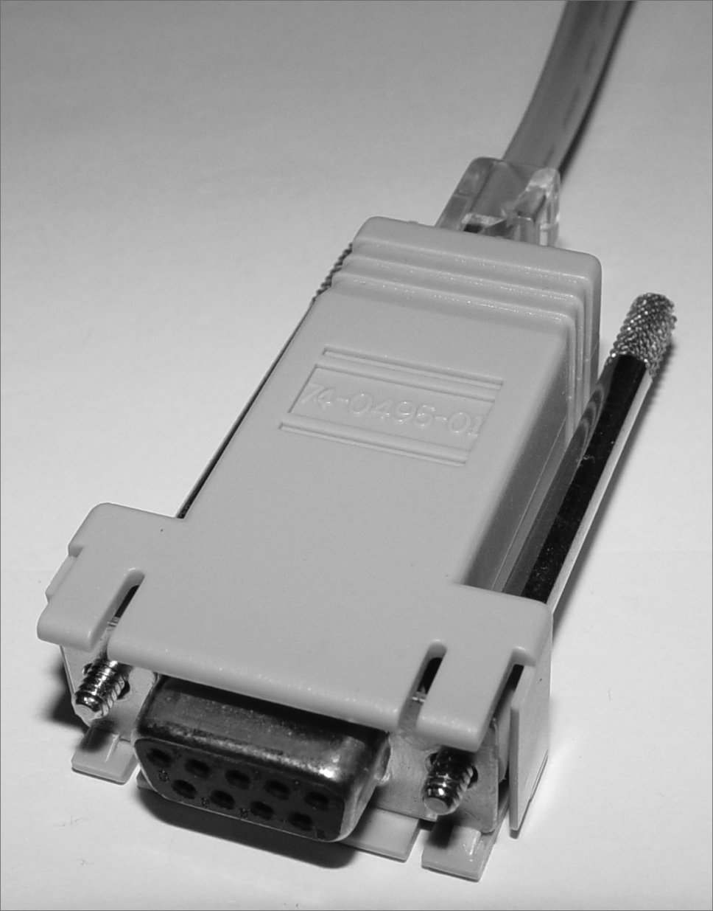
Universal Serial Bus
Notes:
Universal Serial Bus
Hubs can be chained together and you can actually plug up to 127 devices using USB

Slide 17
Cable Properties
Speed
Distance –Attenuation
Duplex
Noise/Impedance
Notes:
Speed is the rate at which data transmits through your network
Distance has to deal with how far the signal has to travel
The degradation of a signal due to the medium and the distance is known as attenuation
Half-duplex vs Full-Duplex
Half-duplex is when a device can either send or receive comms at a given time, but not the same time (think walkie-talkies)
Full-duplex is when both devices can send and receive comms at the same time
Noise has to deal with EMI

Slide 18
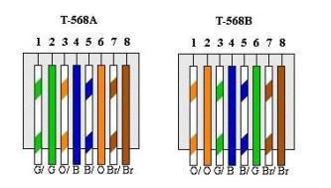
Wiring Standards
Notes:
Learn one and remember the difference with the other
Pins 4, 5, 7, and 8 are the same in both standards

Slide 19


Straight Through Cables
Straight Through
1
1
2
2
3
3
6
6
Notes:
Used to connect unlike devices
Connecting a computer to a switch
T568A+T568A = straight through
T568B+T568B = straight through

Slide 20
Crossover Cable
1
1
2
2
3
3
6
6
Notes:
Used to connect like devices
Switch to a switch
Used only in Ethernet UTP installations
T568A+T568B = crossover

Slide 21

Rollover Cable
1
1
2
2
3
3
4
4
5
5
6
6
7
7
8
8
Notes:
It’s a straight through cable that you simply just turned over

Slide 22
Termination Points
Termination Point | Description
Punch down block | In wiring closets, connects groups of phone or network wires 66 block supports low bandwidth telecommunications transmissions 110 block supports higher bandwidth, data applications
Patch panel | Connection point for drop cables and patch cables At least one row of RJ-45 connectors (ports) Drop cables run from the ISP to the connectors Patch cables run from the panel to network devices
Fiber distribution panel | Enables termination, storage, and splicing of fiber optic cable fibers Adapters connect the cable to the network
Notes:
Fiber distribution panel is a fiber version of a patch panel

Slide 23
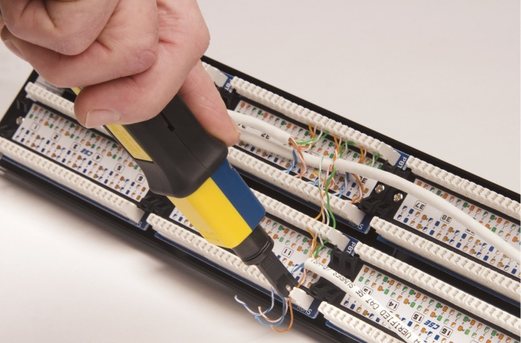
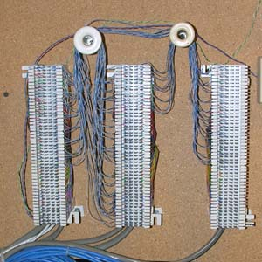
110 Block vs 66 Block

Slide 24
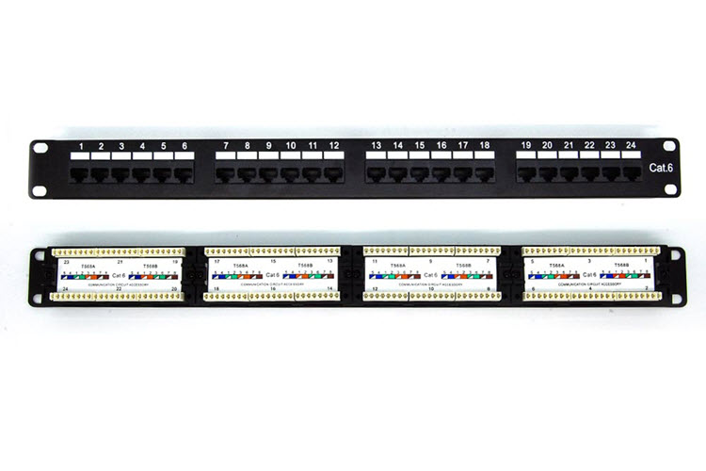
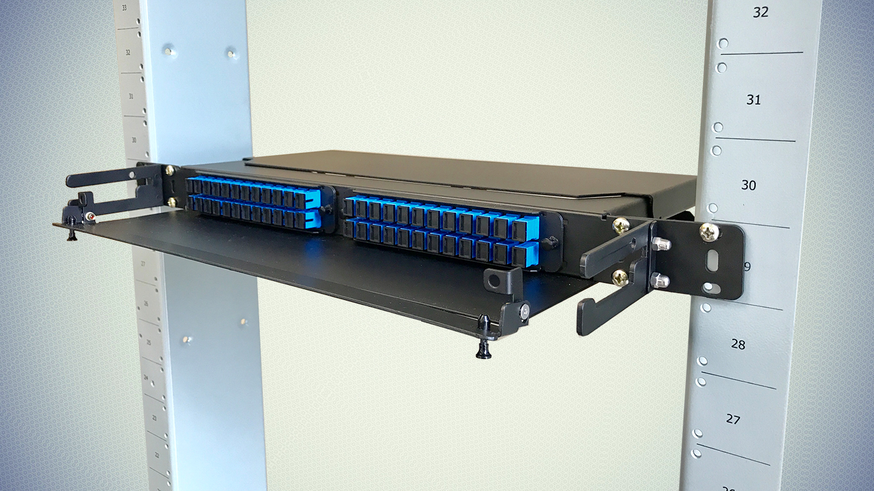
Notes:
This is a patch panel

